Slide 1
Bigdata final project
Hazem hamada Abdellatif mohamed

Slide 2
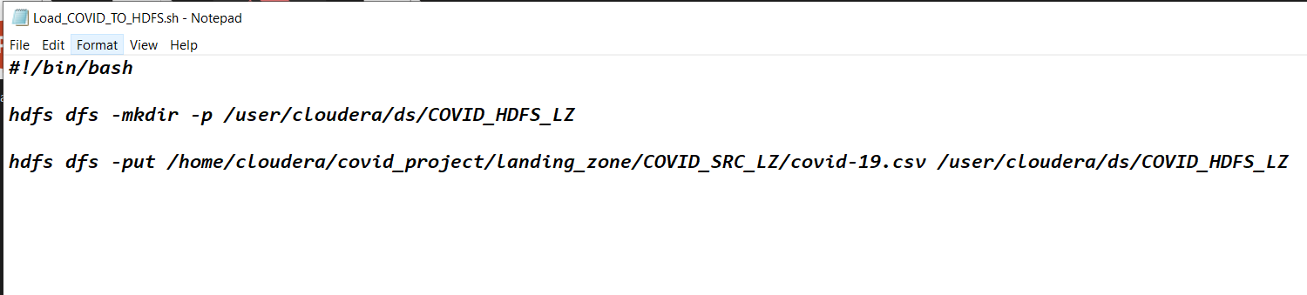
Shell script to upload dataset.

Slide 3
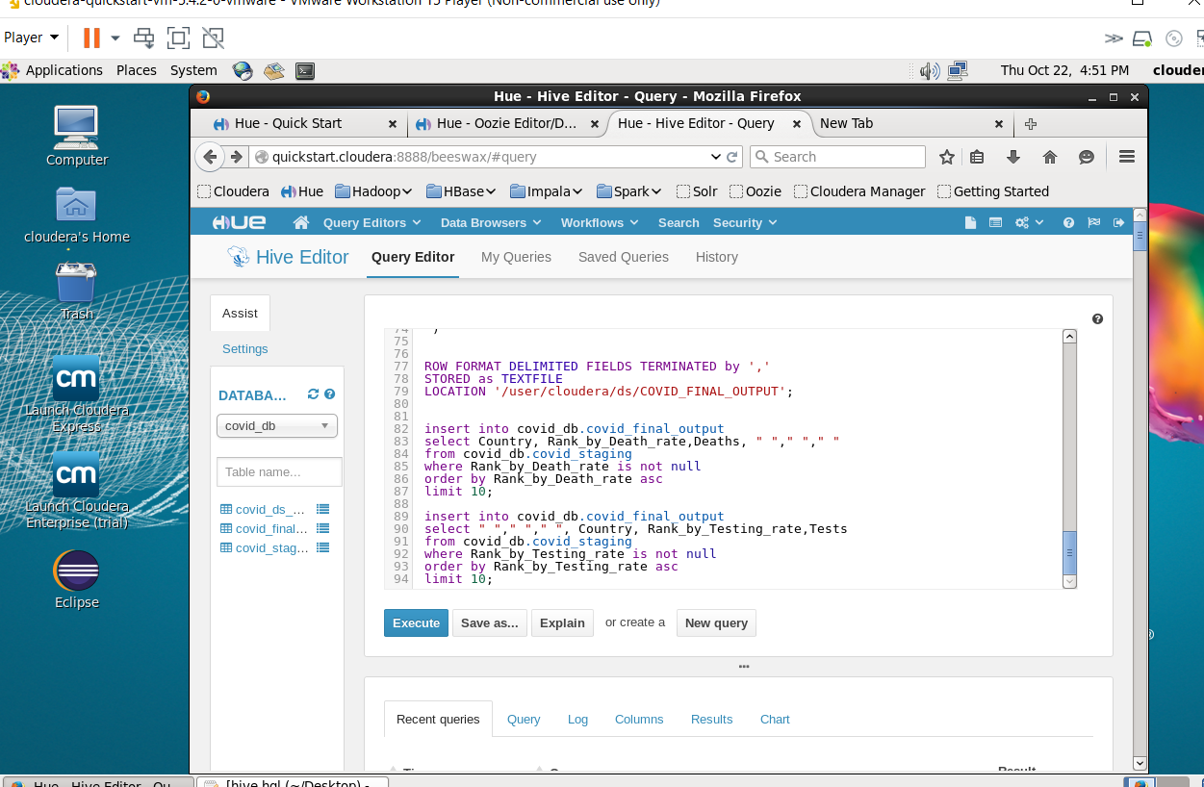
HQL Query.

Slide 4
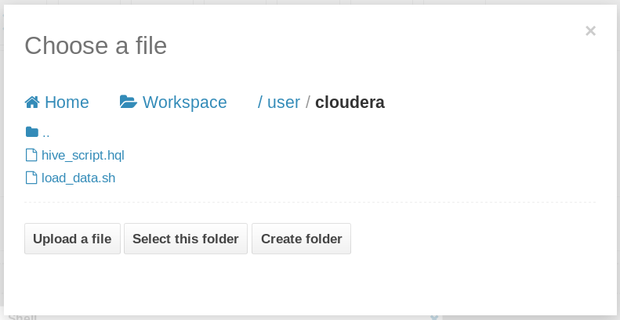
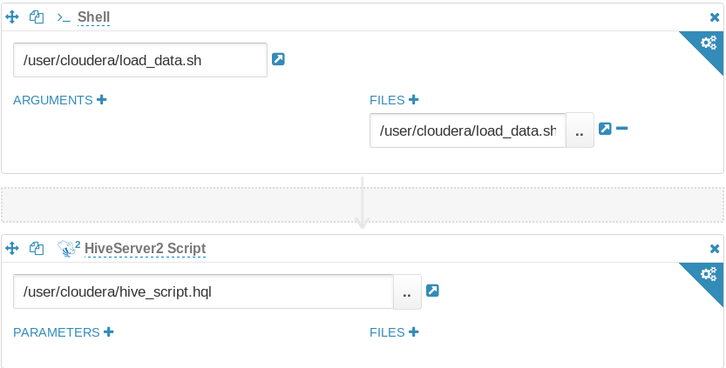
Oozie Workflow.

Slide 5
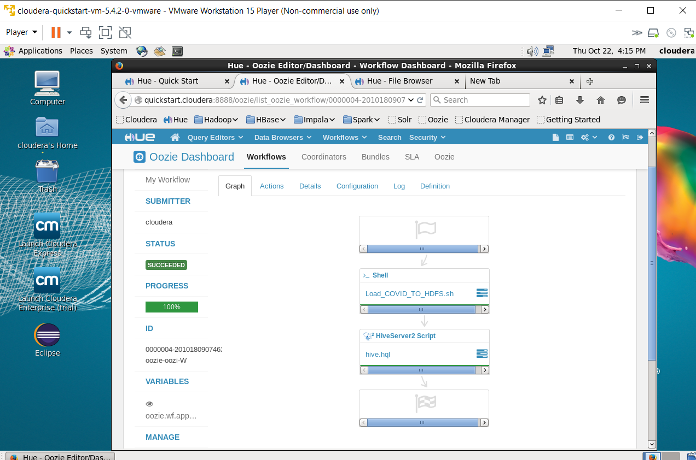
Oozie Workflow.

Slide 6
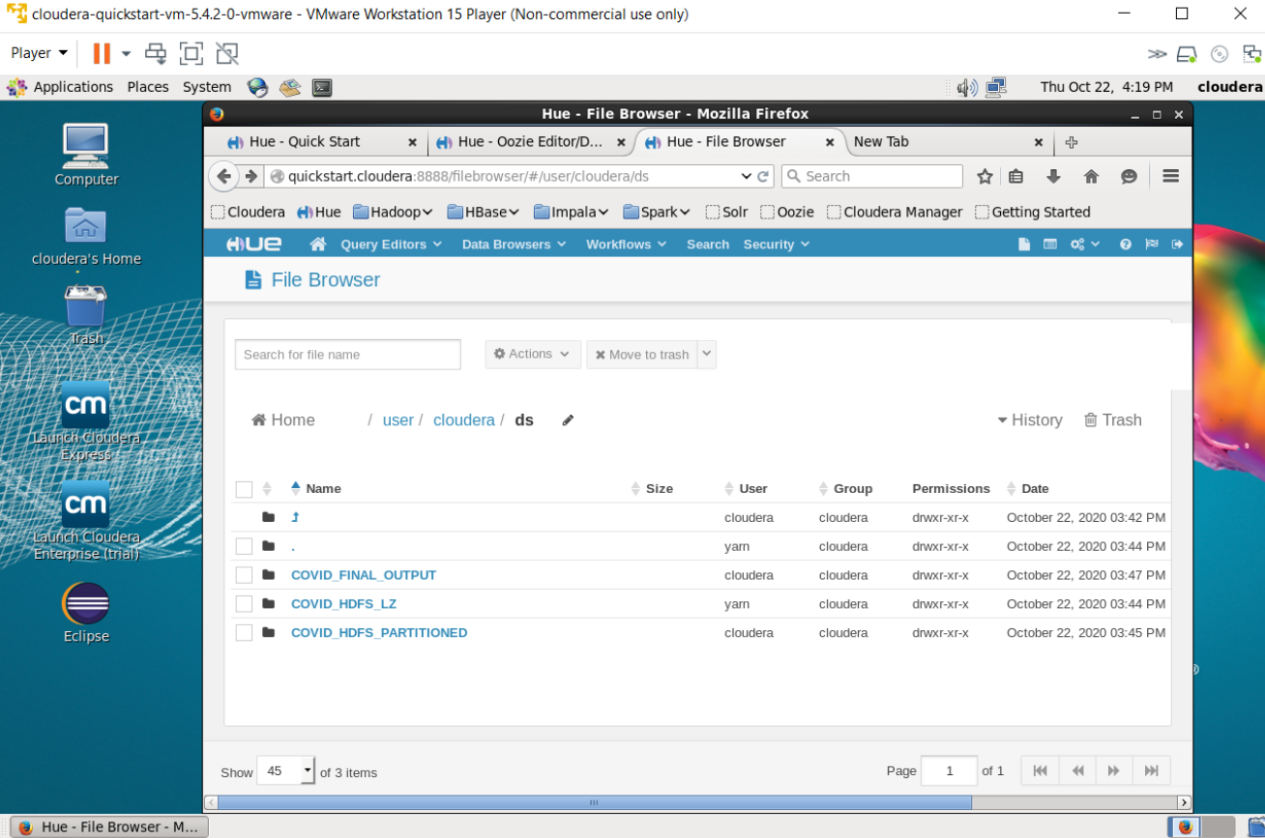
Final output table

Slide 7
Retrieval and correction of output files.
#!/bin/bashecho "TOP_DEATH,RANK_D,DEATHS,
TOP_TEST,RANK_T,TESTS" > output.csvcat
000000_0_copy_2 >> output.csvcat
000000_0_copy_3 >> output.csv

Slide 8
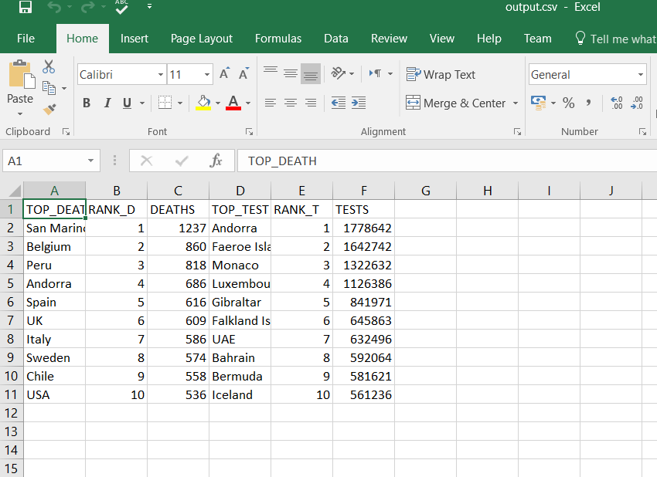
Data After Processing.

Slide 9
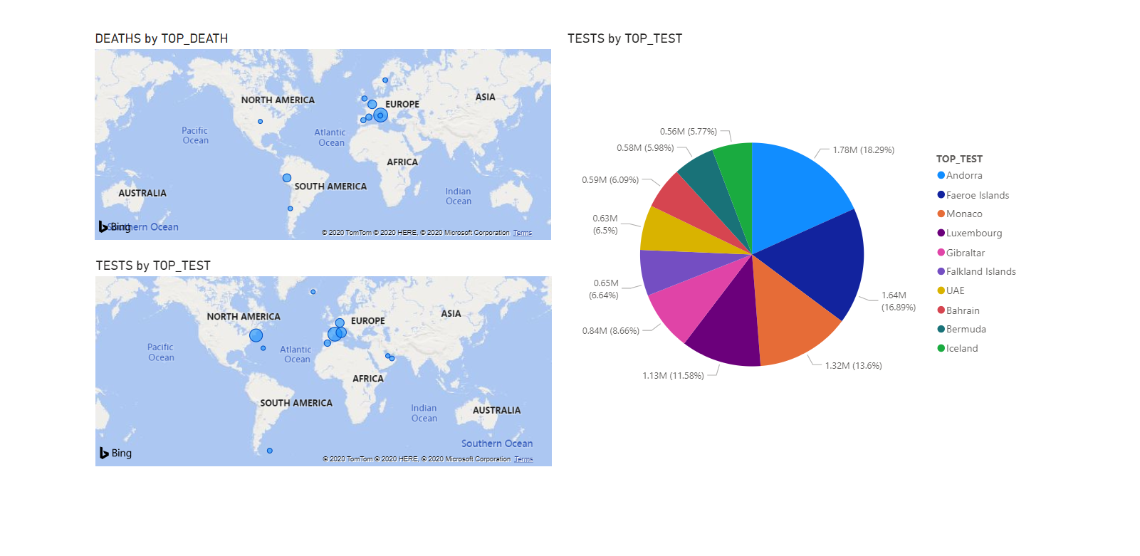
Visualization.

